Slide 1
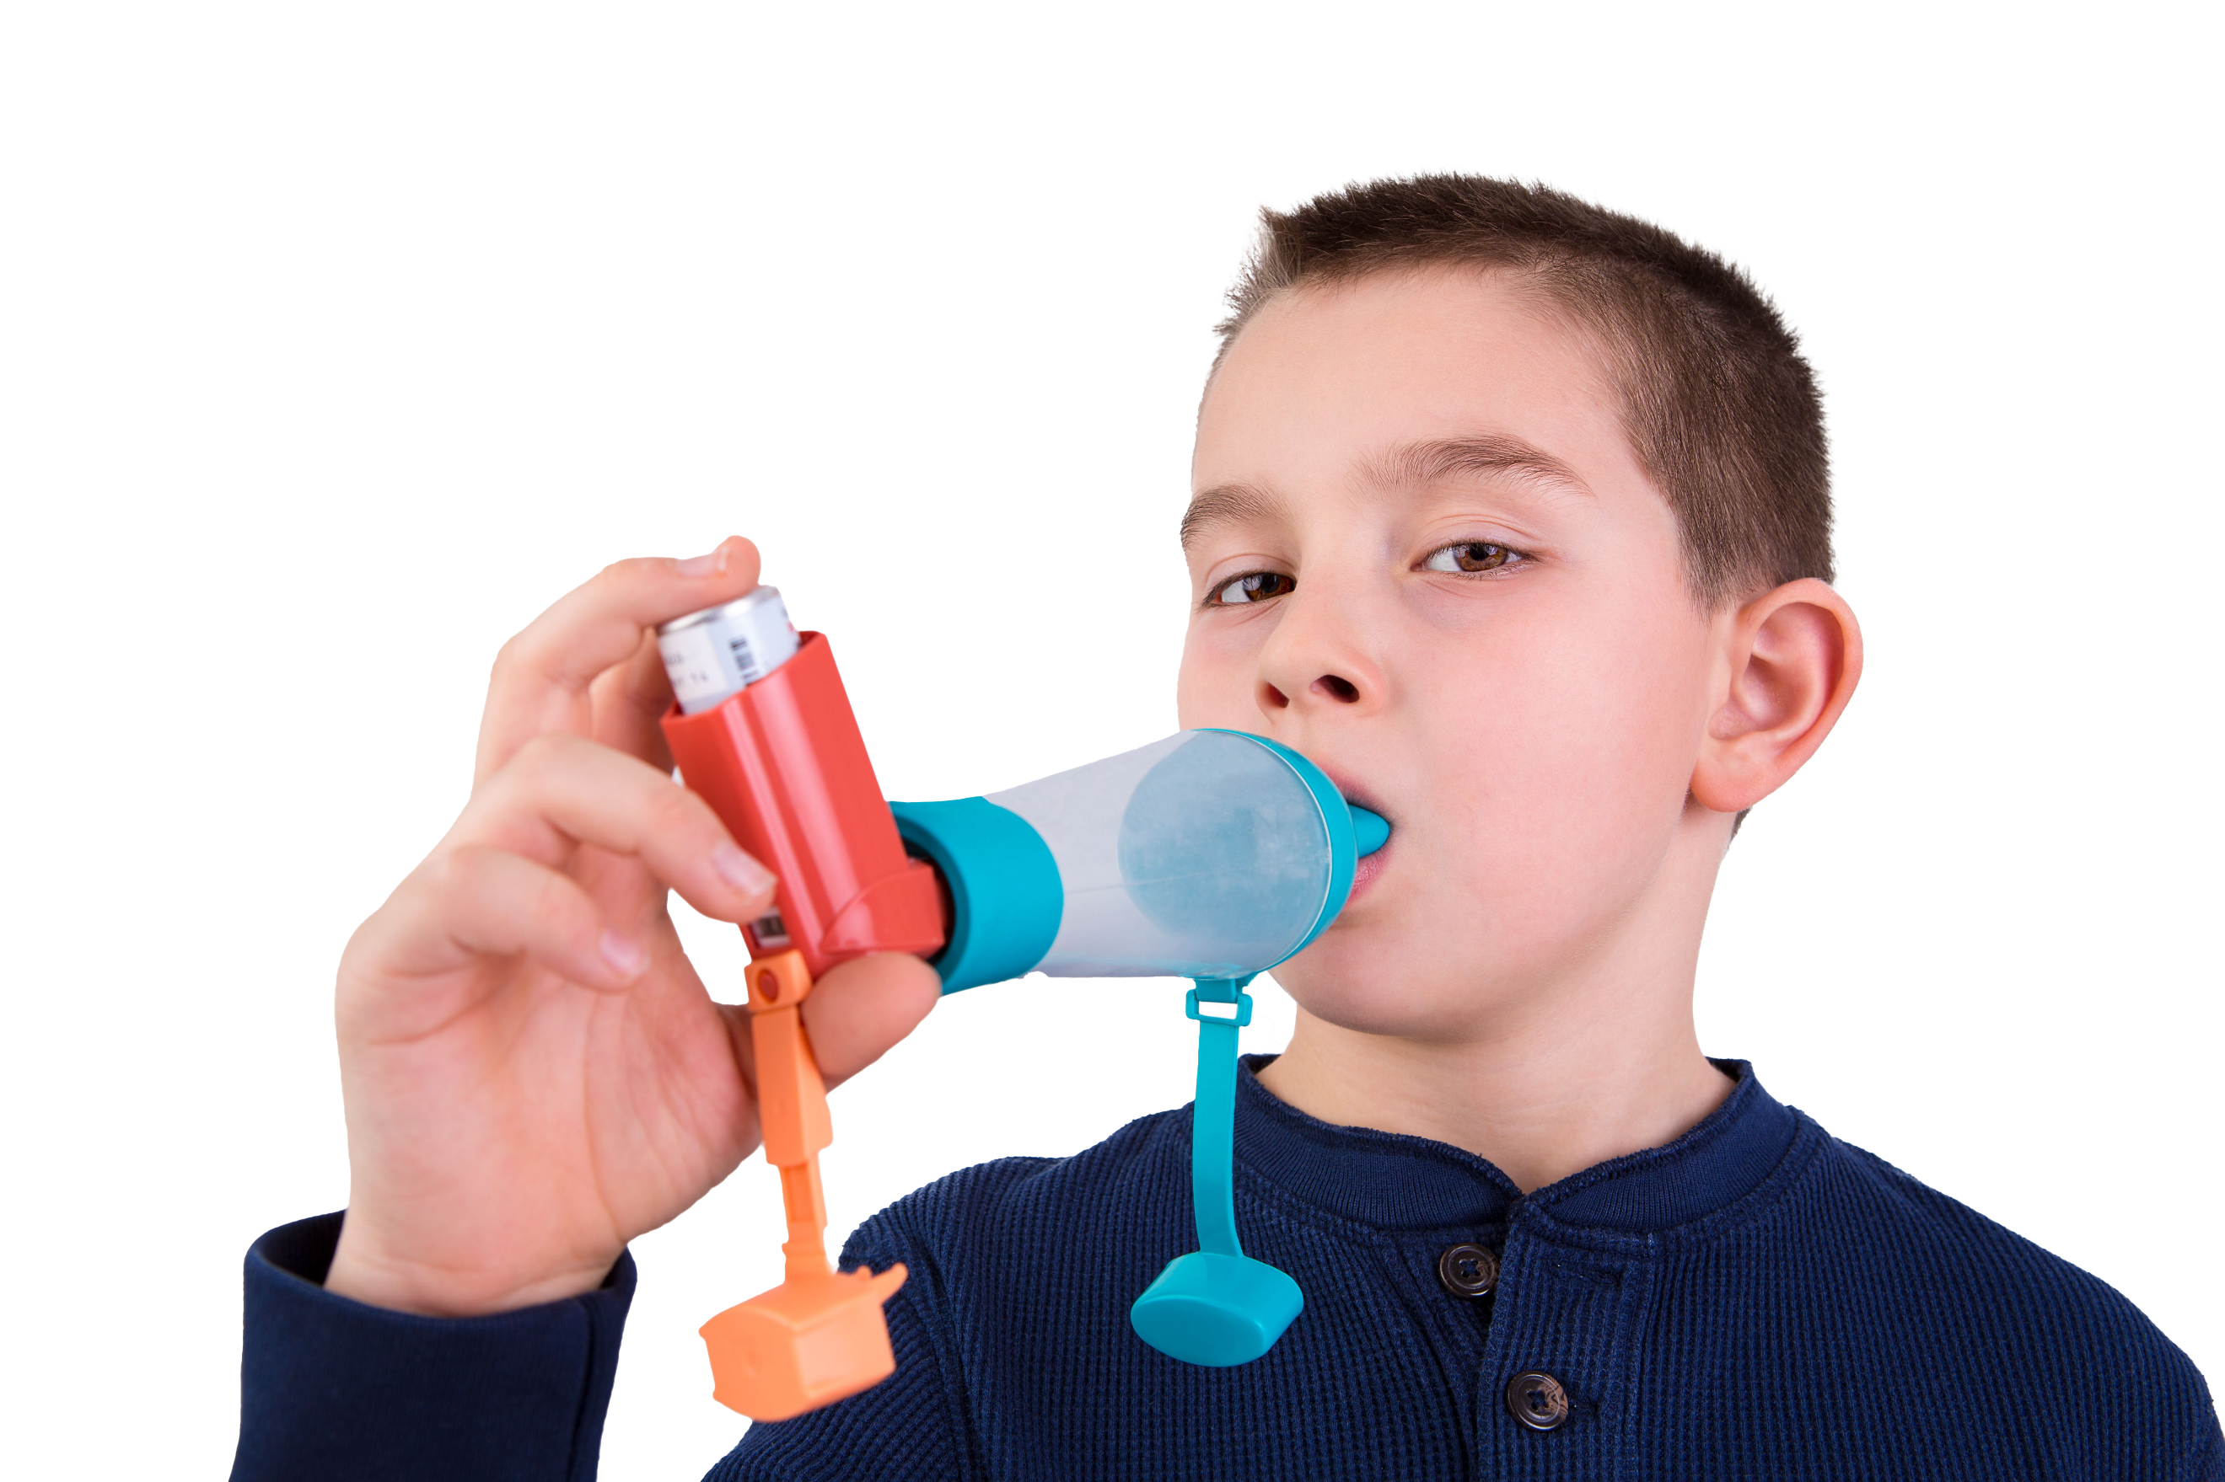
Asthma is the most common long-term medical condition affecting children and young people
1 in 11 are affected by the condition, which is around 3 in every London classroom
Many have badly managed asthma, with over 20,000 admitted to hospital every year in England. Over 4% of these have such a severe episode that they are admitted to intensive care
Children die in London every year because of asthma. 90% of asthma deaths are preventable: these children should have gone on to lead full and productive lives.
#AskAboutAsthma 2024: fact sheet for primary care
London’s annual #AskAboutAsthma campaign raises awareness of 4 simple asks that can make a big difference to how children and young people experience their asthma – having an asthma plan, attending a regular asthma review, using inhalers properly and knowing how air pollution affects them. Good asthma control means no symptoms – asthma shouldn't limit children and young people’s lives in any way.
This campaign has been running for 8 years, led by NHS England – London’s babies, children and young people’s transformation team. This year’s campaign takes place from 9-15 September 2024.
This year’s theme is Helping children and young people with asthma to live their best lives. See the campaign webpage to find out more.
How primary care can support the #AskAboutAsthma campaign:
Develop your own knowledge by attending the #AAA conference and daily webinars, accessing our blogs, videos and podcasts.
GPs and Practice nurses can talk to their young patients with asthma and their families about their asthma care, helping them to understand that asthma is a chronic condition and can be managed with the four asks.
Share messaging around asthma triggers and why it’s important to minimise exposure where practical and possible:
  Smoking: support and more information is available on smoking cessation from Stop Smoking London.
  Vaping: Recommend the Better Health website for support about talking to young people about vaping.
  Damp and mould: Recommend the Asthma + Lung UK website to your patients for information about mould or damp in their homes. You can also refer to the London Damp and Mould Checklist.
Practice managers and reception staff can:
  Call in patients who have not had an asthma review in the past year or have been prescribed reliever inhalers but not preventers.
  Remind anyone using a nebuliser, that they should only be used if recommended, initiated, and managed by an asthma specialist.
  Display the #AskAboutAsthma campaign poster in reception areas to encourage patients and parents/carers to speak to their GP, nurse or pharmacist if they need help managing their asthma. Also see our spotting signs of asthma poster to help families understand if their child might have asthma and should be assessed.
Did you know…?
London has a higher rate of illness and death in children and young people because of asthma compared to other European countries.
Contact us
For more information, contact the #AskAboutAsthma team on: england.cyptransformationldn@nhs.net
Follow us on social media to stay up to date on the campaign:
X: bcyp_nhsldn
Instagram: bcyp_nhsldn

