Slide 1


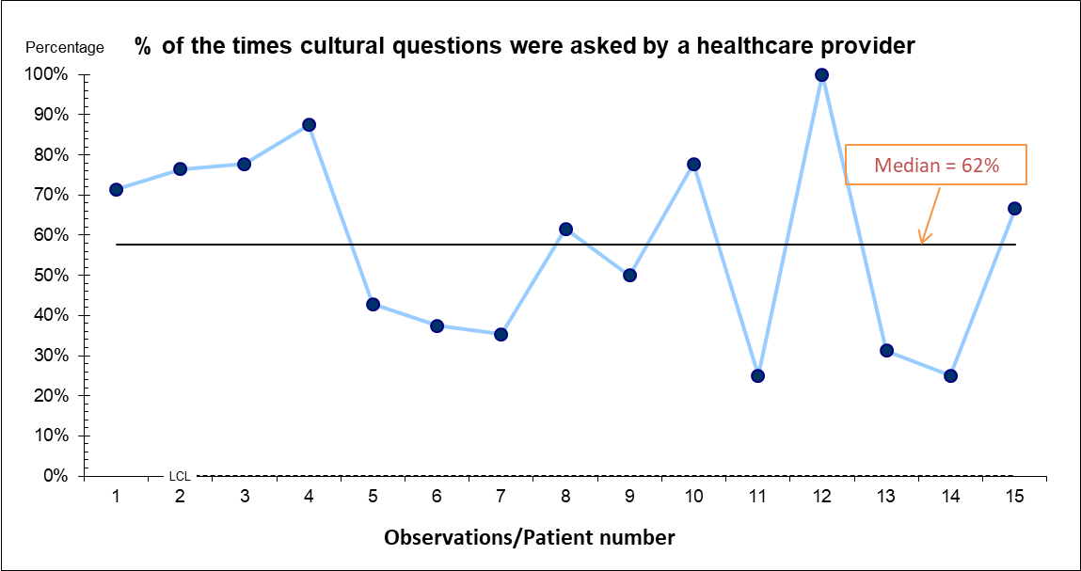
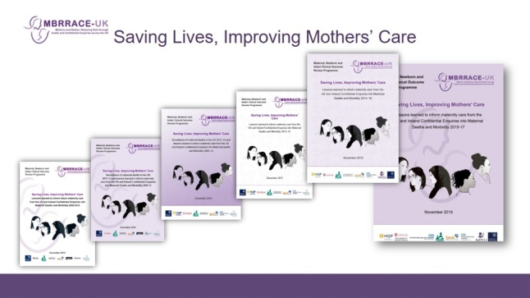
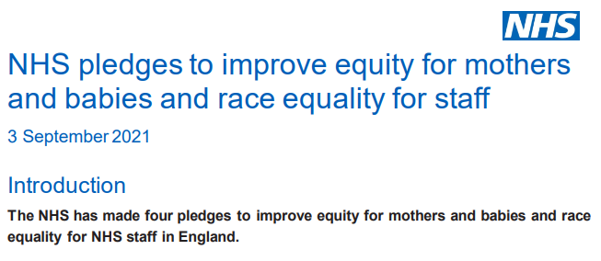

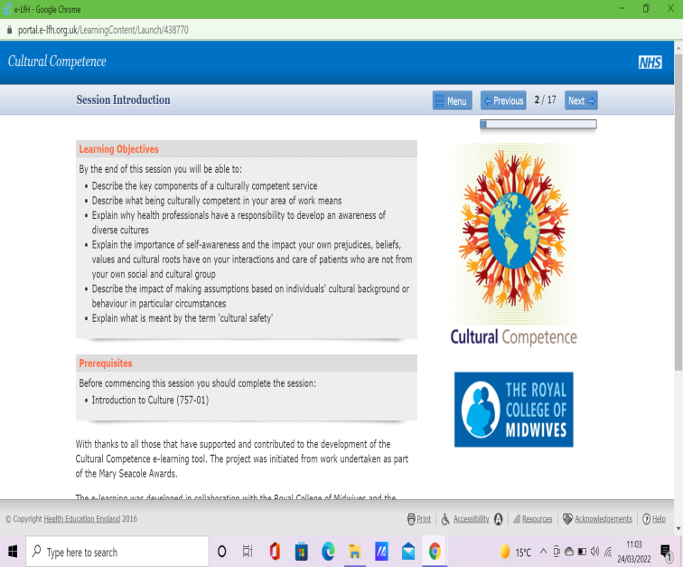
Improving Equity In Maternity for Black and Ethnic Minority Women
Dionne Thompson
dionne.thompson@nhs.net
March 2022
Introduction
The Approach
Mothers and Babies: Reducing Risk through Audits and Confidential Enquiries, Nov 2021
This Mothers and Babies: Reducing Risk through Audits and Confidential Enquiries-UK (MBRRACE-UK) report shows yet again the stark disparity in maternal mortality rates between women from Black and Asian aggregated ethnic groups and White women – more than four times higher for Black women, two times higher for mixed ethnicity women and almost twice as high for Asian women. Apart from a slight drop in the maternal mortality rate for Black women, this bleak picture has not changed in over a decade. We remain deeply concerned that Black and Brown people’s basic human rights to safety, dignity, respect and equality in pregnancy and childbirth are not being protected, respected or upheld.
What we were trying to accomplish
To increase cultural awareness for staff working in maternity services and have an impact on care given and outcomes for Black and Ethnic Minority women.
What we measured to understand if our change was an improvement
Increase in Black and Ethnic Minorities survey results and to use the information received to improve care.
Increase in the times a health care professional asks a woman in the antenatal period about her wellbeing currently 62%.
Our inquiry has also heard how previous life experiences – racist attitudes, microaggressions, dismissal of concerns, breakdown of trust – can affect interactions with maternity services. This report cannot capture the impact of this prior experience, but it must be recognised and better understood. Although we cannot hear the voices of the women whose deaths are examined in this MBRRACE-UK Confidential Enquiry, it is clear that basic human rights are still challenged at many levels. (MBRRACE-UK 2021)
National Health Service Pledge Sept 2021
The NHS made a pledge to improve equity for mothers and babies and race equality for staff. Equity means that all mothers and babies will achieve health outcomes that are as good as the groups with the best health outcomes.
For this, maternity and neonatal services need to respond to each person’s unique health and social situation – with increasing support as health inequalities increase – so that care is safe and personal for all.
The uptake of maternity staff completing the cultural competency training.
What changes we made/are making
Introduction of cultural competences training.
Introduce a questionnaire before and after completing the training to measure any benefits from undertaking the training.
Gaining better data from the Black and Ethnic Minority Survey in order to learn from the responses and improve care given.
Having more face to face discussions around cultural awareness and how this would improve equity and reduce inequalities.
Priority 4d) Support for maternity staff to
Roll out multidisciplinary training about cultural competence in maternity service.
When investigating serious incidents, consider the impact of culture, ethnicity and language. (NHS 2021)
Improvement methodology
The Impact
Continuous improvements using PDSA cycles
Once all maternity staff completing cultural competence training they will have a better understanding and awareness of how a person’s culture can effect there health and health outcomes. Staff should have new skills and confidence in asking about a person’s wellbeing from a cultural point of view and have a better understanding how self-bias can impact on care given.
Providing the opportunity for women’s voices to be heard.
Staff will more culturally sensitive. taking into account a person’s culture when providing care and how this can reduce inequalities and increase equity.
Improving health outcomes for our Black and Ethnic minority women.
Black and Ethnic Minority women’s experience in maternity
1.a)
Plan | Summary: Use information gathered by the LMNS Black and Ethnic Minorities women’s experience in maternity services survey to inform staff on cultural competency training our women’s experience using our service.
Do | Review responses already collected.
Study | Only 3 women have completed the survey for the whole LMNS, 2 women from our Hospital. Not enough responses to gain valuable insight on women’s experiences.
Act | Face to Face walk around the unit asking women to fill out the survey and highlighting survey to staff and requesting that they recruit women to complete the survey. Attend Community Midwives monthly meeting to asking them to recruit women to fill it the survey.
Leadership Learning
1.b)
Plan | Summary: Use information gathered by this survey to inform staff on cultural competency training what Black and Ethnic Minority woman experience in our maternity service.
Do | Attend Community Midwives meeting asking them to recruit women from Black and Ethnic Minority groups to complete the survey.
Study | Community Midwives did not have the information cards about the survey to ask the women to complete. This information was supposed to have been given out to all community midwives around six months ago.
Act | Ask LMNS for more information cards for Community Midwives – No more cards available. No funding to produce new information cards. Ask if new cards can be funded by maternity dept, discussed as an agenda item on the bi monthly BAME operational meeting – No Funds available to produce new cards. Agreed to photocopy old cards and laminate for distribution to Community Midwives. Discussed with QI team at coaching session –Plan -to ask charities if this is something they would provide funding for. Use responses from the survey in face to face teaching sessions.
Increased use of communication skills, Lead and motivate.
Collaboration with different teams – Divisional level conversations, QI teams, Training team, Black and Ethnic minorities operational group, Community midwives, Unit midwives and support staff.
Building new relationships.
Next Steps
Introduction of cultural competency training for all maternity staff groups
Continuing the project – Using PDSA cycles.
Changing things that don’t work and come up with other measures.
Produce a cultural competency face to face training session for when face to face learning restarts.
Continue to collaborate with different teams/people bringing a voice and awareness to improving equity
1.c)
Plan | Introduce cultural competencies for all staff
Do | Due to Covid 19 – staff training is all online learning and not face to face so unable to delivery cultural competency training in that format. Review eLearning for health cultural competency training for suitability and recommend appropriate training package for staff to complete.
Study | Decide if training would be mandatory for all staff – This will have implications for their training compliance figures and the departments training compliance figures = Discuss at divisional level. It was agreed at divisional level to be mandatory for all maternity staff.
Act | Introduce cultural competence training for all staff = Working with the training team and the learning academy. Devise a survey using survey monkey to send to staff before and after completing the training to gain information on how beneficial the training was and whether it will impact on how the give care in the future.
References
Mothers and Babies: Reducing Risk through Audit and Confidential Enquiries –UK 2021. Retrieved 26/03/2022 from https://www.npeu.ox.ac.uk/mbrrace-uk/reports
National Health Service Pledge 2021. Retrieved 26/03/2022 from https://www.england.nhs.uk/wp-content/uploads/2021/09/C0734-ii-pledges-to-improve-equity-for-mothers-and-babies-race-equality-for-all-staff.pdf
1.d)
Measure effectiveness of cultural competencies training
Plan | To see how often a woman was asked about her wellbeing during her antenatal appointments.
Do | Audit 15 Black and Ethnic Minority women’s antenatal notes to see if they had been asked about their wellbeing.
Study | 62% of women were asked by a health care professional about their wellbeing at her antenatal appointment.
Act | Introduce cultural competency training to all staff and see whether the number of time this question is asked increases.

