Slide 1

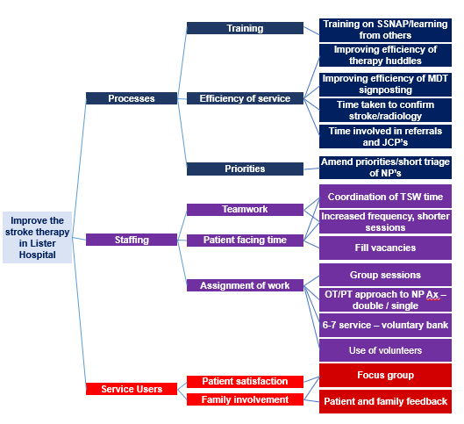

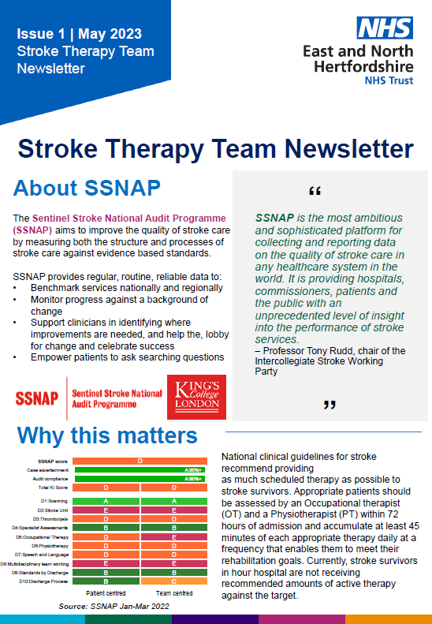
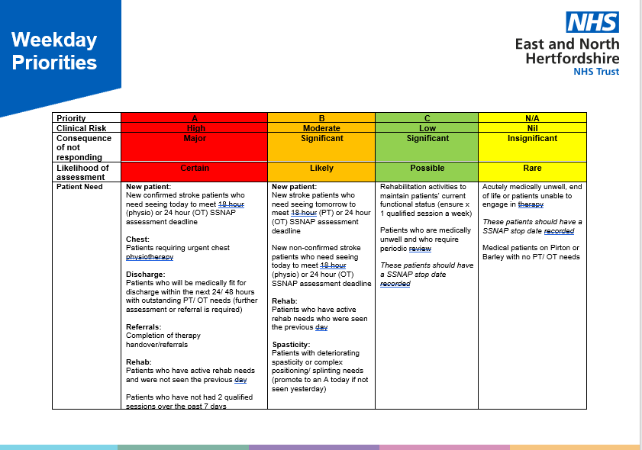
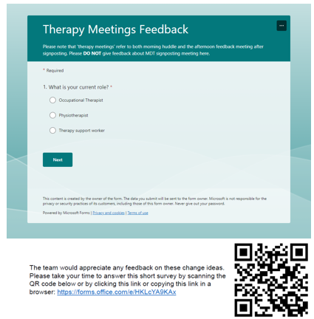
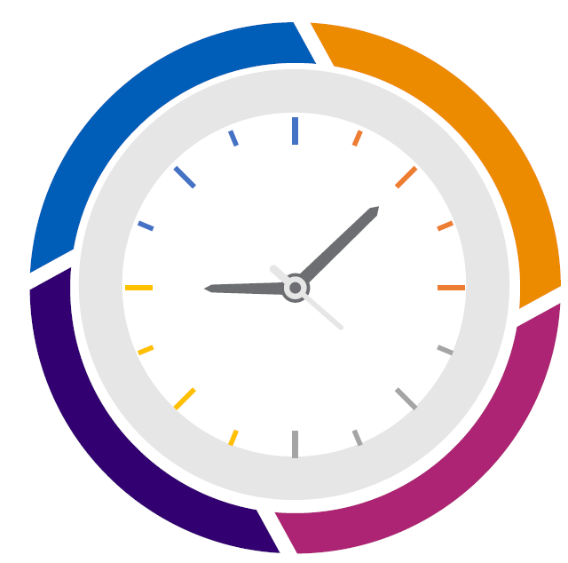
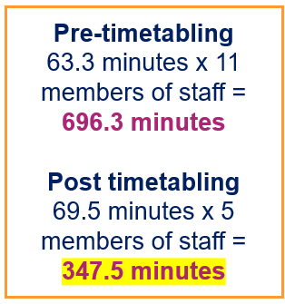
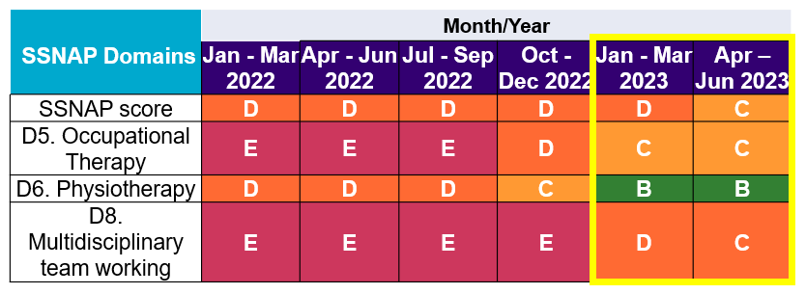
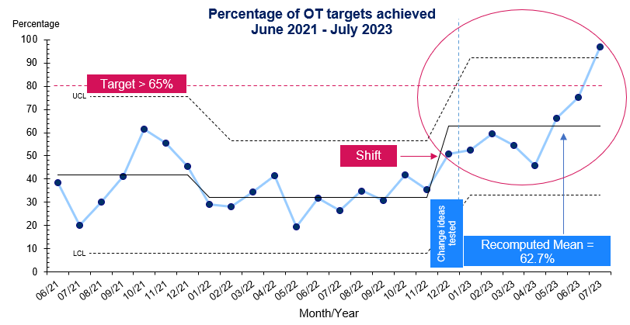
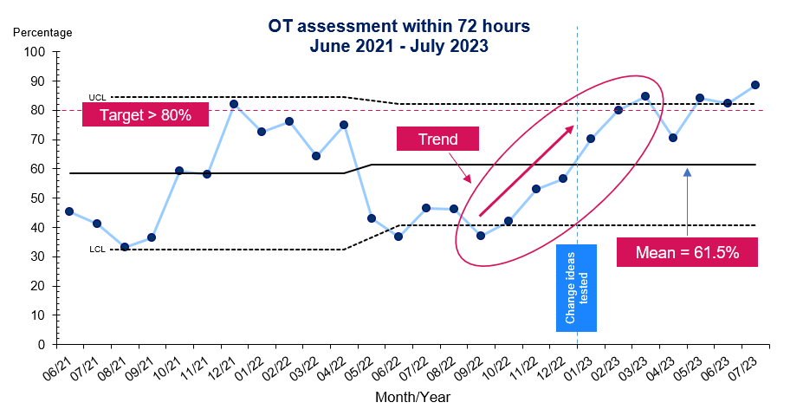
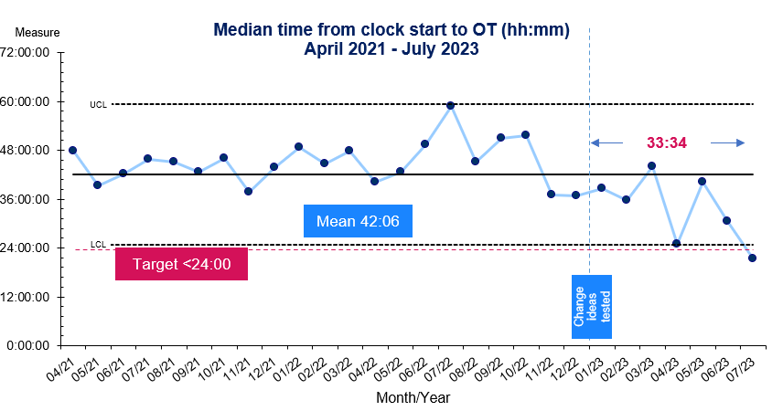
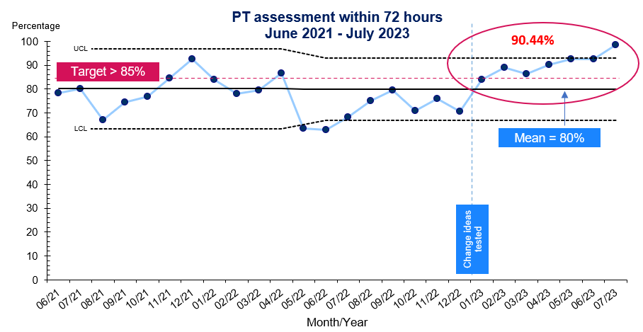
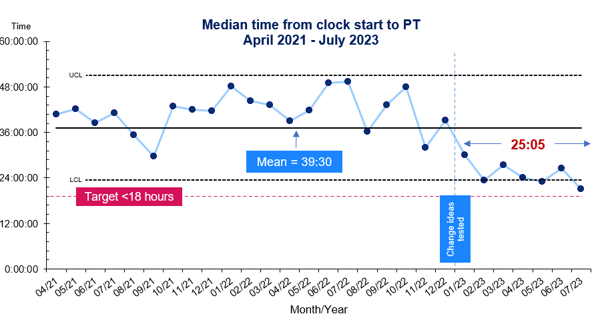
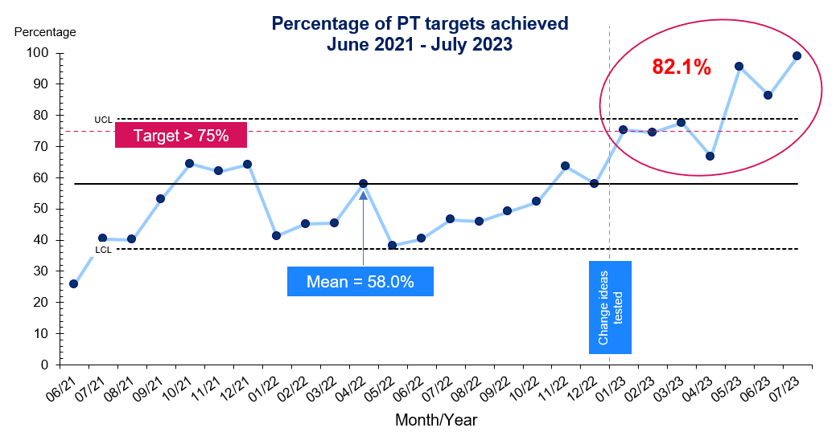
Improving the stroke therapy service in Lister Hospital
Project Leads: Claire Wells (Lead Occupational Therapist))
Julia Sartorius (Lead Physiotherapist)
Project Background
National clinical guidelines for stroke recommend providing
as much scheduled therapy as possible to stroke survivors. Currently, stroke survivors are not receiving recommended amounts of active therapy against the target.
Aims of the project
To improve the stroke therapy service in Lister Hospital, specifically:
Improve percentage compliance against OT/PT targets by December 2023
  OT from 35.9% to 65%
  PT from 47.4% to 75%
Improve the percentage of applicable patients assessed by OT/PY within 72 hours by December 2023 by the:
  OT team from 55.4% to 80%
  PT from 76.8% to 85%
Improve the median time from clock start to OT/PT by December 2023:
  OT team from 44:14 to less than 24 hours
  PT from 41:18 to less than 18 hours
Driver Diagram
Change ideas
Improve prioritisation of patients
Improve Therapy Support Worker (TSW) allocation of work
Improve efficiency and usefulness of therapy meetings
Therapy Newsletter (education)
Improve access to therapy service across 6-7 days
Project Outcomes
Reducing the number of staff attending meetings has positively impacted capacity, hence, more time was spent seeing more patients and assessing them earlier.

