Slide 1
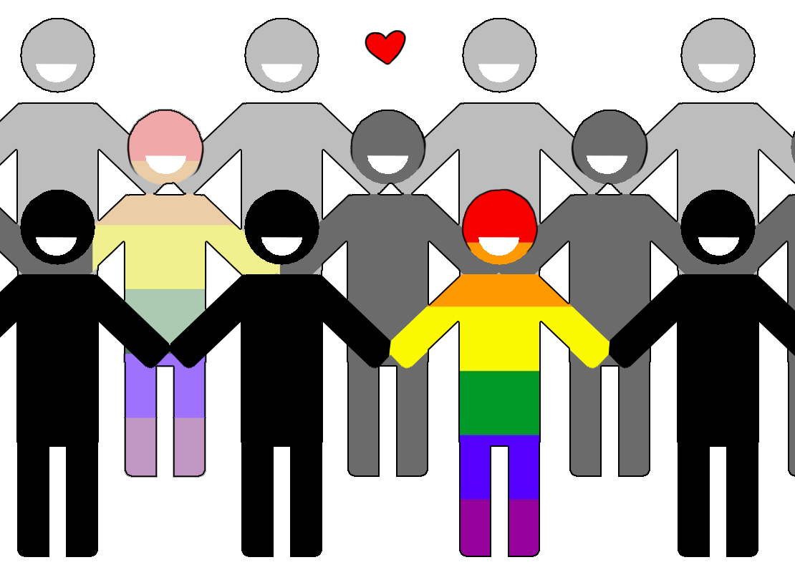
LGBTQ+ Inclusion and Support with a focus on neuro-diversity and gender-diversity: A co-produced multi-method service evaluation.
Dr. Laura Coulthard
laura.coulthard1@nhs.net
Working with LGBTQ+ individuals: NHS Staff experience survey (n= 287)
Lived experience survey: Experiences of LGBTQ+ support in health settings (n=69)
NHS staff across North East/North Cumbria completed an on-line survey.
This asked about knowledge, skills, awareness and confidence when working with LGBQT+ individuals.
LGBTQ+ individuals completed an on-line survey. This asked about gender identity, neuro-diversity and mental health.
Open ended questions asked about experiences and views of LGBTQ+ inclusion and support in health settings, what could be improved and how.
75% had accessed mental support health
Respondents generally rated their mental health as “in the middle”
GD* group reported significantly poorer mental health than CG* group (p=0.05).
83% had discussed LGBTQ+ topics with people they worked with
Only 55% felt confident discussing LGBTQ+ topics
LGBTQ+ staff were significantly more likely to speak about LGBTQ+ topics than the non-LGBTQ+ allied group (p=0.008).
30% identified as neurodiverse
GD group were more likely to identify as neurodiverse compared to CG group (p=0.01)
56% stated that having LGBTQ+ conversations with a health practitioner was important; 12% said this was ‘not at all important’.
86% of staff said LGBTQ+ awareness is important
79% of staff were interested in further LGBTQ+ training.
How can NHS services improve LGBTQ+ inclusion & support?
71% of respondents offered 222 comments
Thematic analysis identified 4 ‘more of’ themes
Staff who self-identified as LGBTQ+ or LGBTQ+ ally (79%) were significantly more interested in receiving LGBTQ+ training compared to the non-LGBTQ+ allied group (<0.0001).
LGBTQ+ conversations were significantly more important for GD respondents (p=0.003)
Staff training (n=48)
Visibility (n=22)
Inclusion (n=44)
Support groups (n=48)
Recommendations
Statutory LGBTQ+ training for all staff
Training should include gender diversity
LGBTQ+ awareness raising in all services
Increase community support (i.e. NHS groups, charity sector)
Greater LGBTQ+ visibility (i.e. publicly embed policies, visibility of LGBTQ+ staff)
Embed ‘signs of inclusion’ (i.e. asking pronouns, data recording

