Slide 1
Gold Quality Improvement Programme February - September 2023
TRANSFORMING POAC INTO
PERI-ASSESSMENT
Annie Allen, CSM POAC, Peri-Operative
Jacqui Wilson, Peri-Operative Project Manager
Notes:
Recommendations for using this template:
Refer to this notes section on each slide, using the pointers provided to build your presentation narrative.
Presentation narrative should stay in the notes section or be transferred into a separate script document if you prefer.
The narrative you build becomes the key messages to talk through during your presentation.
Keep slide space clean. One large image, or a few smaller ones, as a visual prompt for your key messages will generally work well.
Keep any text on slides to a minimum. Research shows people struggle to process text on a slide while also trying to listen to a presenter.

Slide 2
Background
7
STEPS
of Quality
Improvement
PROJECT CHARTER |  |  |  | Transforming POAC into Peri-Assessment
Project Sponsor | Somerset Foundation Trust |  | Project Lead(s) | Annie Allen / Jacqui Wilson | Project Manager |  | Jacqui Wilson
Preferred Start Date | 01/06/2023 |  |  | Preferred Completion Date | 01/12/2024
Actual Start Date | 01/07/2023 |  |  | Planned Completion Date | 01/12/2024
Organisational Strategy | The Somerset system’s shared vision for health and care in the county is: “to support the people of Somerset to live healthy and independent lives, within thriving communities, and with timely and easy access to high quality and efficient public services when they need them |  |  | Clinical Aim Strategy | Improve the health and wellbeing of the population. Provide the best care and support (we can) to children and adults. Strengthen care and support in local communities. Reduce inequalities. Respond well to complex needs
Service | POAC / Peri-Operative |  | Directorate | Surgical Services | Location | SFT (MPH / YDH)
Description |  | The POAC team are seeing elective surgical patients too close to surgery to enable optimisation causing last minute cancellations, increased rate of complication and LOS and / or readmissions. A 2 year acquisition process has resulted in the implementation of a digital Pre-assessment tool (Pathpoint) to enable faster screening of patients and the ability to identify Peri-Operative strategies for patients significantly sooner in their patient journey
Background |  | This is a historic issue experienced by 100% of patients. Addressing this will improve patient experience and outcomes. Peri-Operative Services has been in pilot operation across the Somerset system since 2021 with the aim of identifying health, wellbeing and medical optimisation strategies for surgical elective patients on the waiting list. Funding has recently been awarded to launch the service, focusing primarily on patients on the inpatient waiting list with diabetes, anaemia and who smoke.
Objectives |  | To improve surgical outcomes we will increase screening from 0% to 80% of all patients who require elective major inpatient surgery at MPH. To improve surgical outcomes we will then offer optimisation to those with diabetes, anaemia and who smoke from 01/09/23 to 01/04/2024
Return on Investment |  | Using operational SFT figures we anticipate Peri-Operative care will enable a 15% reduction in the demand on SFT POAC in 2024/25 i.e a saving of £150K. Digital improvements will lead to efficiencies in remaining POAC appointments meaning around 20% of patients will be triaged to avoid POAC entirely. |  |  |  |  | Budget | £500K
Project Dependencies Successful recruitment to key posts; Peri-Assessment nurse, Peri-Operative Lead Anaemia Nurse to compliment the existing Lead Diabetes SpN and Tobacco reduction Team resource
Project / Service / Pathway |  | Status | Description or nature of dependency |  |  | Direction IN / OUT |  |  | Date
Peri-Operative Service |  | G | Successful Recruitment to role – Peri Assessment Nurse |  |  | IN | Advertise role |  | 01/09/23
Peri-Operative Service |  | G | Successful recruitment to role – Peri-Operative Lead Anaemia Nurse |  |  | IN | Advertise role |  | 01/09/23
Pre-surgery optimisation work streams
ANAEMIA
DIABETES
Frailty
Nutrition / Dietetics
Alcohol
Weight Mg’ment
Exercise
Emotional Support
Pain Mg’ment
Advance Care Planning
Cancer
SMOKING
Health Coaches
Processs D’ment
Notes:
AA
Due to Covid and backlog, Talk to audience to help them understand the issue we have – the way the system currently works
Non-clinical in the audience – describe peri-op

Slide 3
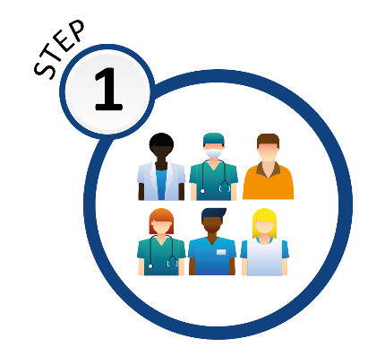
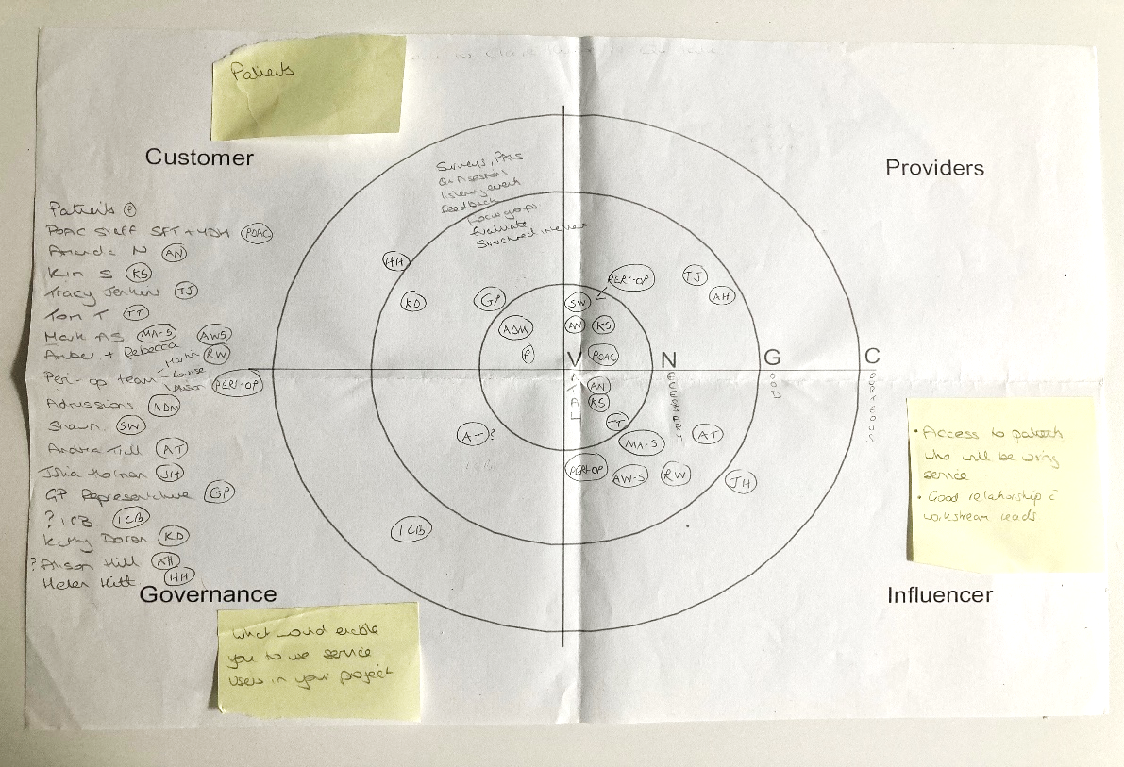
People – forming our project team
7
STEPS
of Quality
Improvement
TEAM
Project Team: Annie Allen, Jacqui Wilson
Anaesthetic Leads: Tom Teare, Mark Abou-Samra
POAC: Amanda Newell, Ashraf Ahmed, Tracey Jenkins, Kim
Saunders, Sam Goss, Tracey Gunn, Di Vickery
Peri-Op: Louise Lewis, Martin Lever, Peri-Op Anaemia Nurse Specialist, Care Co-Ordinators, Project Support
Digital Nurse Lead: Shawn Whelan
Patient Partner: Joyce Strandring
Our Learning
At the beginning of the project, we didn’t forward plan or future proof the project team and have since recognised that we needed to include more people
Notes:
JW
Reflectnig back on how the team members changed over time

Slide 4
People – forming our project team
May 2023 - Exciting developments in pre-operative assessment in Somerset
POAC / Peri-Op workshop - colleagues from our pre-operative assessment clinic.
“Just one of the developments we’ve been working on is the introduction of a new pre-operative digital system, called Pathpoint, which we hope will be in use across the trust soon”, Amanda Newell, Clinical Manager, POAC
Notes:
JW
To launch relationships …

Slide 5
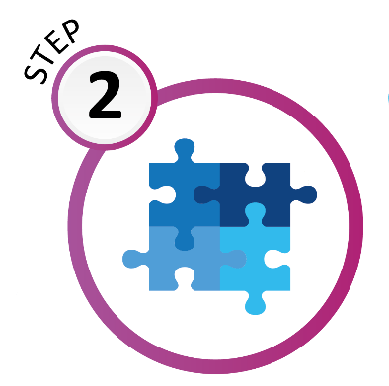
Problem Understanding
7
STEPS
of Quality
Improvement
PROBLEM
What was our problem
The POAC team are seeing elective surgical patients too close to surgery to enable optimisation causing last minute cancellations, increased rate of complication and LOS and / or readmissions.
How long had this been happening
This is a historic issue experienced by 100%.Addressing this will improve patient experience and outcome
Our Learning
We predicted that Improved Outcomes would score highest – and it did – we did this several times
and then again a few
months later with the same result
Notes:
AA
AA to read problem statement
Reflecton that Improve outcomes and care experience both scored high – every time

Slide 6
Aim Statement
7
STEPS
of Quality
Improvement
AIM
To improve surgical outcomes we will increase screening from 0% to 80% of all patients who require elective major inpatient surgery at MPH.
To improve surgical outcomes we will then offer optimisation to those with diabetes, anaemia and who smoke from 01/09/23 to 01/04/2024
Our Learning
We’ve revisited our aim statement many times! We were too ambitious and not realistic enough. This is where we utilised the invaluable help of our IA (thank you Clair) – who helped us to be realistic and set achievable targets. We revisited our AIM statement again as we were prepping this presentation and considered all those factors outside of our control; Pathpoint being deployed later than expected, training took longer, data collection downloads still not available, Peri-op staff not in place (expected in June – won’t be until Sep/Oct). With a (successful) business case decision received in June we were able to proceed financially. We always knew this would be a long term project but
revisiting our AIM statement has been pivotal
to the progress of the project
Notes:
JW
JW Read Aim statement.
Revisited many times. Helped us to be realisted – first put 100%.
We know that 60% of all patients have completed and returned – across all GA surgical patients

Slide 7
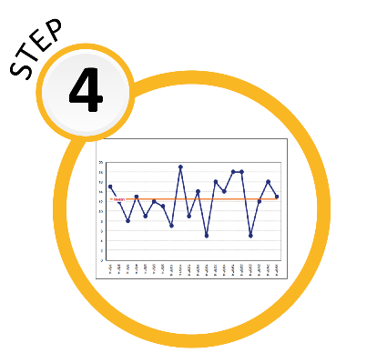
Measures
7
STEPS
of Quality
Improvement
MEASURES
Outcome measure:
Measure % of patients receiving Pathpoint questionnaire PLUS % of patients returning the form
Process measure:
Measure number of patients being supported with Diabetes, Anaemia & Smoking PLUS accuracy of form
Balancing measure:
Setting our criteria too low could
result in more patients being
identified than we have capacity to optimise
Our Learning
Considering the outcome, process and balancing measures of our project provided a valuable insight into the actual impact on what were trying to achieve. Our balancing probably went onto prove to us the unintended consequences of being too ambitious in our approach and enabled us to consider the broader impact on the
project if we aimed too high.
Notes:
AA
100% of all patients should now be receiving a Pathpoint questionnaire
How many have gone out – how many have come back – SW
Balancing measure – useful to understand numbers – 2/3 of patietns have either A, D or are smoking

Slide 8
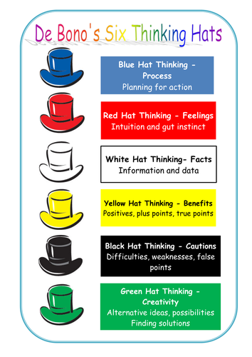
Change Ideas
7
STEPS
of Quality
Improvement
CHANGE IDEAS
Driver Diagram
Our Learning
This proved to be one of the most challenging phases of the project for us. Our team consistently generated a multitude of excellent change ideas however, factors such as limited resources, time constraints, and the implementation of a live Pathpoint system required a significant reliance on manual data collection which inevitably brought about its own set of obstacles. To evaluate these ideas effectively, we adopted various tools and methodologies, including DeBono’s Six Thinking Hats. These techniques proved invaluable in directing our attention and concentrating
our efforts towards understanding
the potential value of
each change idea.
PRIMARY DRIVERS
SECONDARY DRIVERS
CHANGE IDEAS
Pathpoint
Collect HB results for 1000 POAC patients / identify most prevalent anaemic pathways
Identify patients
Assessment nurse
Identify risk factors for anaemia for patients already on our waiting list
Referral pathways
Peri-Op Anaemia Nurse working with PC to identify surgical elective anaemic patients
Care Co-Ordinator
Care Co-Ordinator working in the community (Bridgwater Bay)
Patient engagement
Communications
iPad/tablet in OPD for patients who are not digitally enabled
Raising awareness, OPD poster
Patient Involvement
Audit drop in sessions
Recruitment
Contact non-responders
Referral Pathway(s)
Test Pathway(s)
Recruit to posts
Staff Engagement
Create content and referral form through Teamnet workstreams in PC
Notes:
AA
Driver Diagram
Utilised DeBono’s hats from another workshop (adapt tools and methodology to suit different teams and groups of people)

Slide 9
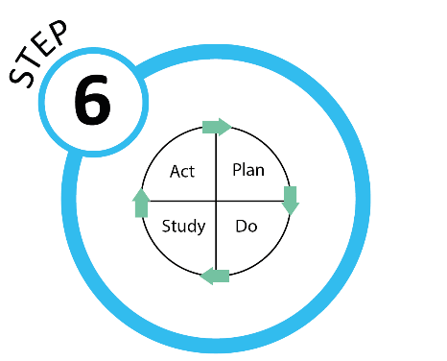
PDSA (Plan, Do, Study, Act)
7
STEPS
of Quality
Improvement
PDSA
(Ideas & Outcomes)
What was the outcome from some of our PDSA Change Ideas:
HB results for 1000 (POAC) patients collected to identify most prevalent anaemic pathways. PDSA confirmed national statistics that c. 30% of surgical elective patients are anaemic. 25% of these patients are on a T&O pathway with next most prevalent pathways for anaemic patients being Gynaecology, Urology & Colorectal.
MAY 23. Pathpoint go live. 847 questionnaires sent to patients. 333 received back, i.e 40% of patients completed and returned the questionnaire in the 1st wave.
To raise awareness we created a poster for OPD and clinicians. This increased the return rate to 60%.
We revised the wording of the text message being sent to patients from 'please complete your POA questionnaire’ to ‘Pre-Operative Assessment questionnaire’. Patients didn't understand the POA acronym, thought it was a scam and therefore didn't complete the questionnaire.
We recognized that a stronger message was needed along the lines of ‘If you are unable to complete your questionnaire, this may delay your surgery – contact us for support’
Prior to the launch of Pathpoint and with training in place across the POAC team, 12% of patients had a Clinical Frailty Score (CFS) – now 70% of all frail patients have this
Our Learning
Through PDSA cycles, we have truly learnt to improve step by step in a manner which is manageable and not at all daunting!
We planned, tested and analysed results and then made
adopt, adapt, abandon decisions based on what we learnt. Incrementally through the Test & Learn process, this has
taught us how to use information to make things better.
TEST & LEARN
There were many PDSA cycles! 1 example ….
PLAN / DO
Put posters up in OPD clinic rooms and waiting rooms and inform clinicians to tell patients they will be receiving a Pathpoint Questionnaire via email/text.
STUDY
The poster increased the number
of questionnaires being returned
from 40% to 60%
ACT
Adopt! But continue to conduct
audit spot checks with OPD
departments(s)
CLINICIANS
PLEASE INFORM ANY NEWLY
LISTED SURGICAL PATIENT THEY WILL RECEIVE A
‘PATHPOINT’ HEALTH QUESTIONNAIRE
(BY TEXT MESSAGE OR BY EMAIL)
FROM THE
PRE-OPERATIVE ASSESSMENT DEPARTMENT
FOR COMPLETION AND RETURN
Notes:
JW
Lots of PDSA’s
Focus on 1 PDSA cycle here – poster in Outpatients and on Clinicians desk
Increased return rate from 40% to 60% -combination of changing wording in text message
Phone calls – is this a scam? Made message clearer
Talk to last para – excellent outcome

Slide 10
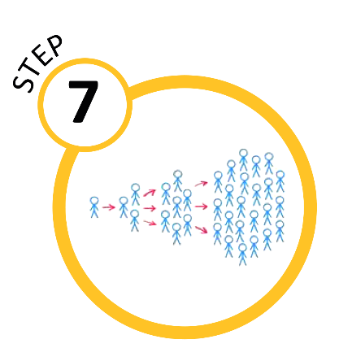
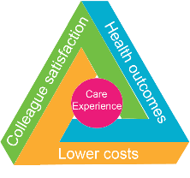
Spread
7
STEPS
of Quality
Improvement
SPREAD
Successfully secured 1st year funding to launch the Peri-Operative Service!
The enhanced Peri-operative service will, over time, transform existing POAC resource to further develop the new Peri-Operative service.
In the future, a patient who has undergone a 45–60-minute Peri-Op assessment (at the earlier point of their patient journey following a decision to treat), will only then require a 20-minute POAC appointment, for final pre-surgical checks including bloods and observations.
The proposed digital improvements will also lead to efficiencies, as patients will be triaged into risk categories, and lower risk patients seen by lower banded staff.
Over time there will be a shift in demand along the lines of that indicated in the graphs here, leading to a transfer of resources as part of the designed transformation from POAC into Peri-Operative Services
Our Learning
Having successfully secured 1st year funding to launch the Peri-Operative Service our vision for ‘Spread’ is to ensure a standardised process, sustained planning and embedded continuous learning. The Quadruple Aim will be an integral focus of the next steps in our journey
Notes:
AA
Read verbatim from slide

Slide 11
Summary of Project Benefits
7
STEPS
of Quality
Improvement
PROJECTS BENEFITS
Project benefits are already being seen with a small % of patients being screened and assessed earlier in their pathway. Long term anticipated benefits:
Colleague satisfaction:
Our approach encourages problem-solving and mutual learning among employees leading to increased productivity. This enhances overall problem-solving, creates potential for change and boosts efficiency for remote working teams
Health outcomes:
Patients with undiagnosed conditions such as diabetes and anaemia will have their condition identified and optimized more quickly, leading to less time in poor health. Patients will have opportunity to improve their overall health, i.e by reducing smoking to ensure a quicker recovery post-surgery.
Lower costs:
Shorter length of stay in hospital due to swifter recovery. Shorter period with restrictions on normal daily activity. Fewer re-admissions to hospital post-surgery and, in some cases, decision not to surgical treat
Care experience:
Time spent waiting for surgery is invested in optimising health and supporting lasting lifestyle improvements. Patient are fully informed about the risks and benefits of surgery, thereby increasing patient empowerment. Fewer instances of patient regret post-surgery
Helping our surgical patients achieve their goals
 | 1 in 7 patients regret having surgery either because they didn’t achieve the outcomes they were hoping for or worse, surgery created complications they hadn’t been aware of
 | Peri-Operative services aims to optimise the health of patients, from the moment surgery is contemplated through to full recovery. We can help to identify areas where we can make improvements to the patient pathway by optimising long term health conditions, general health, exercise and wellbeing
 | You can help to encourage patient education by remembering our moto ‘Fitter, Better, Sooner’ for surgery
Contact the team for more information: peri.op@somersetft.nhs.uk
Notes:
JW
Read 1st para and talk about quadruple aim
Head, hearts hands poster – useful – goal is to print this for OPD areas

Slide 12
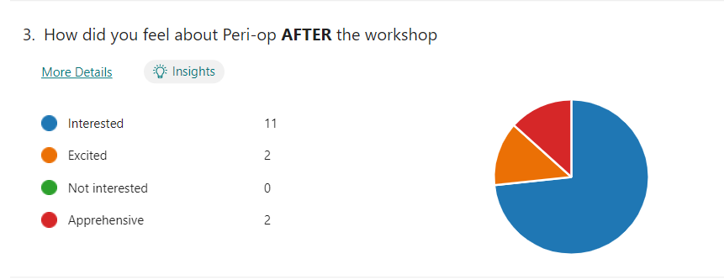
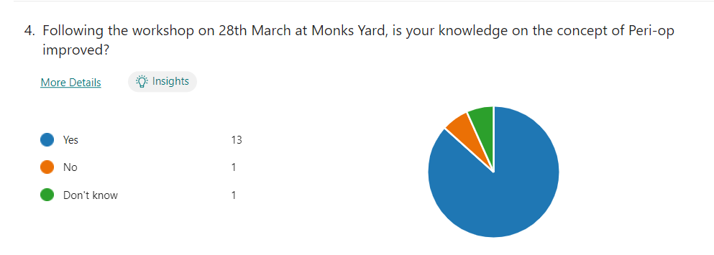
Patient / Service User feedback
7
STEPS
of Quality
Improvement
POAC/Peri-Op Workshop
(March 23)
PRIMARY CARE
““It was very interesting to hear about the project and the success you have had already, a great achievement. I look forward to running these searches and getting our patients engaged.” Peri-Op Diabetes pathway, Practice Nurse” ”
SECONDARY CARE
“Thank you so much Martin for dedicating your time and truly superb motivational interviewing trainer skills. We’ve learnt so much!”. Peri-Op Team
PATIENT
“All in all, this service was a great help on my journey through my treatment. Thank you for increasing my understanding of the importance of prehabilitation” Cancer Prehab Hub
PRIMARY CARE
“It’s great news that the service has been commissioned. We’ve really appreciated your support during this time and have enjoyed working with you and the wider diabetes team”. Peri-Op Diabetes pathway, Practice Nurse”
Notes:
AA
Questionniare following workshop in March – Peri op new concept to some of the POAC teams.
Outcome – removed all apprehensiveness

Slide 13
Gold Quality Improvement Programme February - September 2023
Notes:
Recommendations for using this template:
Refer to this notes section on each slide, using the pointers provided to build your presentation narrative.
Presentation narrative should stay in the notes section or be transferred into a separate script document if you prefer.
The narrative you build becomes the key messages to talk through during your presentation.
Keep slide space clean. One large image, or a few smaller ones, as a visual prompt for your key messages will generally work well.
Keep any text on slides to a minimum. Research shows people struggle to process text on a slide while also trying to listen to a presenter.

