Slide 1
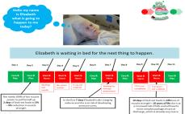
Red2Green
Why is this improvement work important?
Patients spend a lot of time in an hospital bed waiting for things to happen. The longer a patient is in hospital, they are at an higher the risk of harm, such as falls, pressure ulcers, hospital acquired infections. We do not currently have a way to makes visible any delays in the patient’s journey through the system and fix them.
Who is involved?
Stacie Harrington, Ward Manager
Jamie Kapur, Consultant
Sarah Gascoigne, Sister
Lindsay Swain, Ward Clerk
Shona Simmons, Project Support Officer
Kerry Pickering, Improvement Facilitator
Michelle Carroll, Project Manager
Contact for information: Nicola Platts, Programme Manager, nicola.platts@sth.nhs.uk
Aims:
The purpose of Red2Green tool is to make visible what a patient is waiting for on the journey through the hospital from the point of admission through to the point of discharge. The tool focuses the team on identifying what patients are waiting for TODAY that is necessary to progress their care. By the multidisciplinary team discussing red2green at key times in the day and recording the delays for example, decisions and diagnostics, it provides focus on the days tasks, escalate for action if delays are out of their immediate control and provides data to focus their improvement efforts to improve patient experience.
What change ideas have been tested?
March 2018 Improvement facilitators and clinical teams across 3 wards working together to co-design the pilot.
April 2018 2 week pilot
changes made to the E-Whiteboard to support the process. Daily summary red/green patients.
Improvement facilitator present at board round daily to capture additional data and support with common challenges.
Afternoon check-in to reassess red2green daily progress.
All 3 wards agreed to continue the pilot after the 2 weeks. Continue to meet monthly to review data, discuss emerging challenges.
July 2018 – Another respiratory ward started.
What measures were used to monitor improvement? Some of the key measures include:
SAFER dashboard created to enable all wards to regularly review their metrics
Average weekly length of stay
Number discharges AM/PM, hour of the day.
Number admissions from assessment unit AM/PM, by hour of day
Weekly % of non medically fit and medically fit days.
Weekly % red and green days
Medically fit and non medically fit pareto of delay reasons
What changes ideas have been tested?
What are the top 3 key achievements?
Early results show a significant reduction in the weekly average length of stay on two pilot wards, diabetes & endocrine and geriatric medicine by 3.3 and 5.6 days, respectively.
A clear co-designed process at board round and check-in, this has continued beyond the pilot.
E-whiteboard developed to support red2green and supporting electronic data on common reasons for delay to drive service improvements.

Slide 2
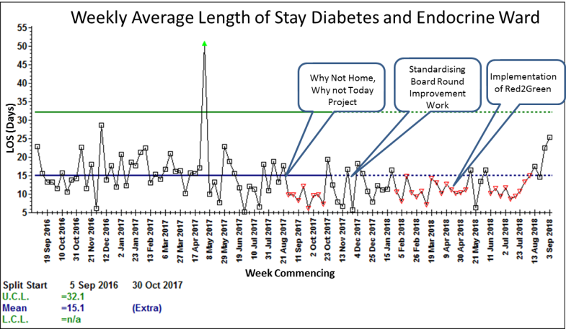
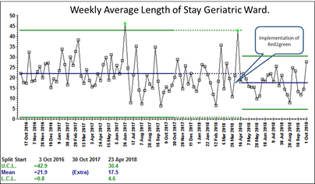
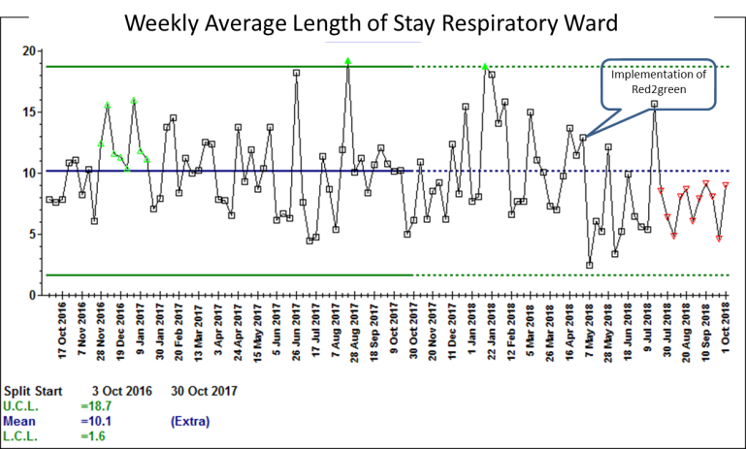
What the team are currently working on:
2 additional geriatric wards and a respiratory ward have started to pilot the red2green tool. The red2green spread pack was used successfully to brief the teams. Light touch Improvement Facilitator support needed.
Consultant champion has written a brief summary of the wards experience of piloting this tool. This being shared widely across the 2 directorates and a drop in session organised for interested wards to learn from the pilot wards
Aim to support all Geriatric and Medicine Wards (13 wards) to be sustaining red2green by December 2018.
Supporting wards to develop weekly improvement meetings to understand the common constraints that prevent the patients’ care progressing.
What have been the challenges and how have you overcome them?
Negative associations with the terms ‘delay’ and ‘red day’
Negative impact on morale – nursing and therapy staff and junior doctors feeling stretched and meeting to check tasks done can be perceived as authoritarian and accusatory if not approached in the right way.
Time needed to collect robust evidence , outcomes data demonstrating that the changes translate into sustained improvements in efficiency or length of stay on the pilot wards.
What has worked well?
Improved communication and handover
Board Round is more focused and decisions are made
Helps identify improvement opportunities.
Having regular meetings to feed back and discuss the benefits, issues and challenges has allowed us reflect on the pitfalls so we can use this learning to share with other ward teams who want to test the process out. We have included an FAQ section in the Red2Green pack that will help teams avoid some of the challenges
Staff and patient stories – how did they feel about the changes?
Extract from Summary of the Geriatric Ward experience (attached) ‘delay categorisation …’ I think this is the most powerful tool for improving efficiency by identifying priorities for service improvement’
‘This has made us tighten our belt’ Ward clerk B2
“If nothing at all has improved it has been the communication between the medical and nursing staff. The check in brings us together…….The check in is kept short, only 10 minutes, and makes all the difference. Holding it at 2:30pm gives us a reminder and gives us chance to do the jobs before the end of the shift’ Sister RH2
Learning
Leadership at all levels, but in particular strong clinical leadership is crucial to drive the work.
Co-design is essential to fit the organisation, rather than one size fits all. There is also benefit in bringing different specialities together, as we found that there are varied benefits and challenges.

Slide 3
